Slide 1
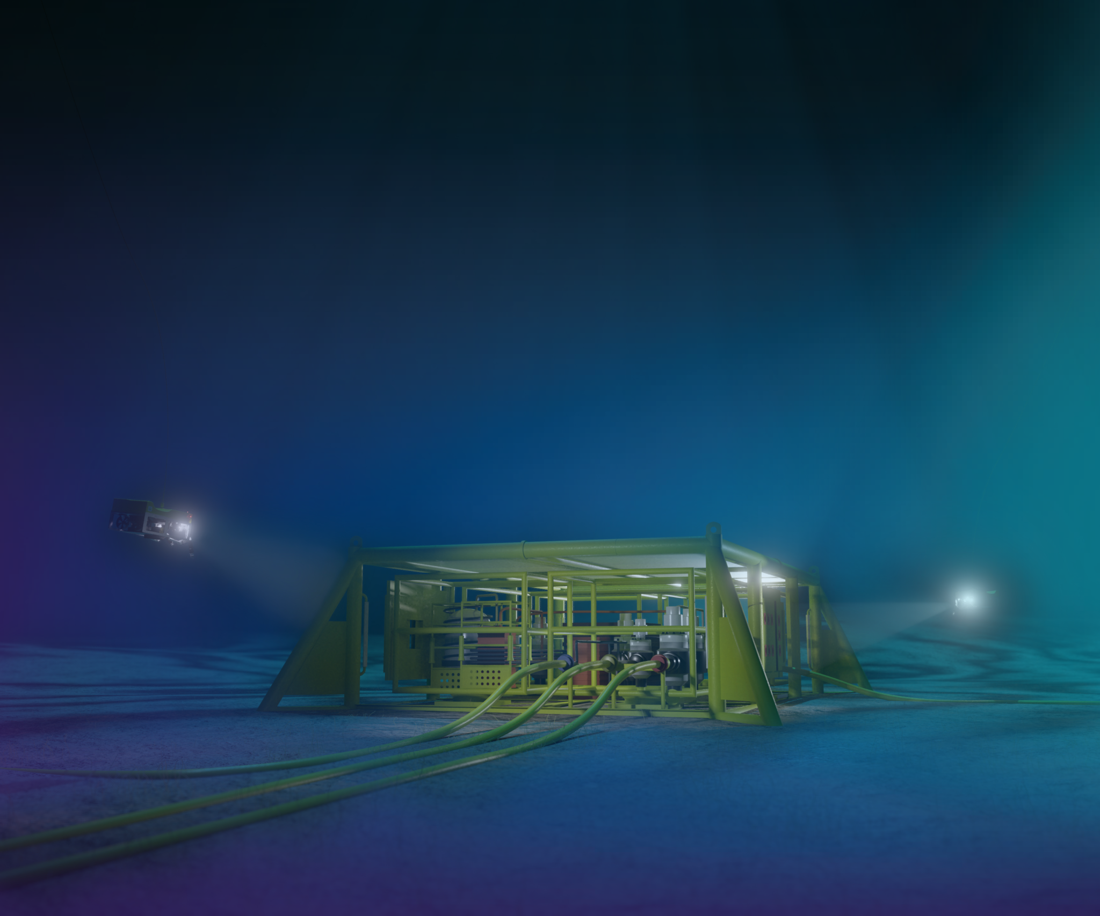




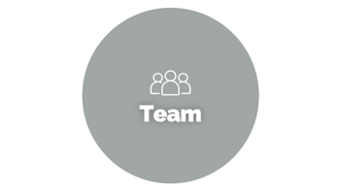




Slide 2

Team

Slide 3
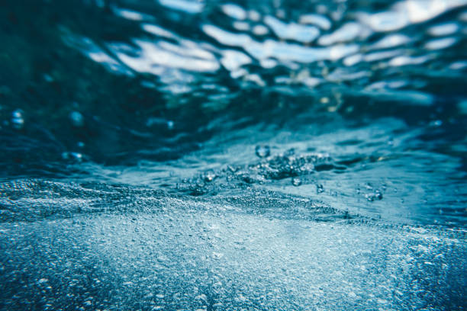

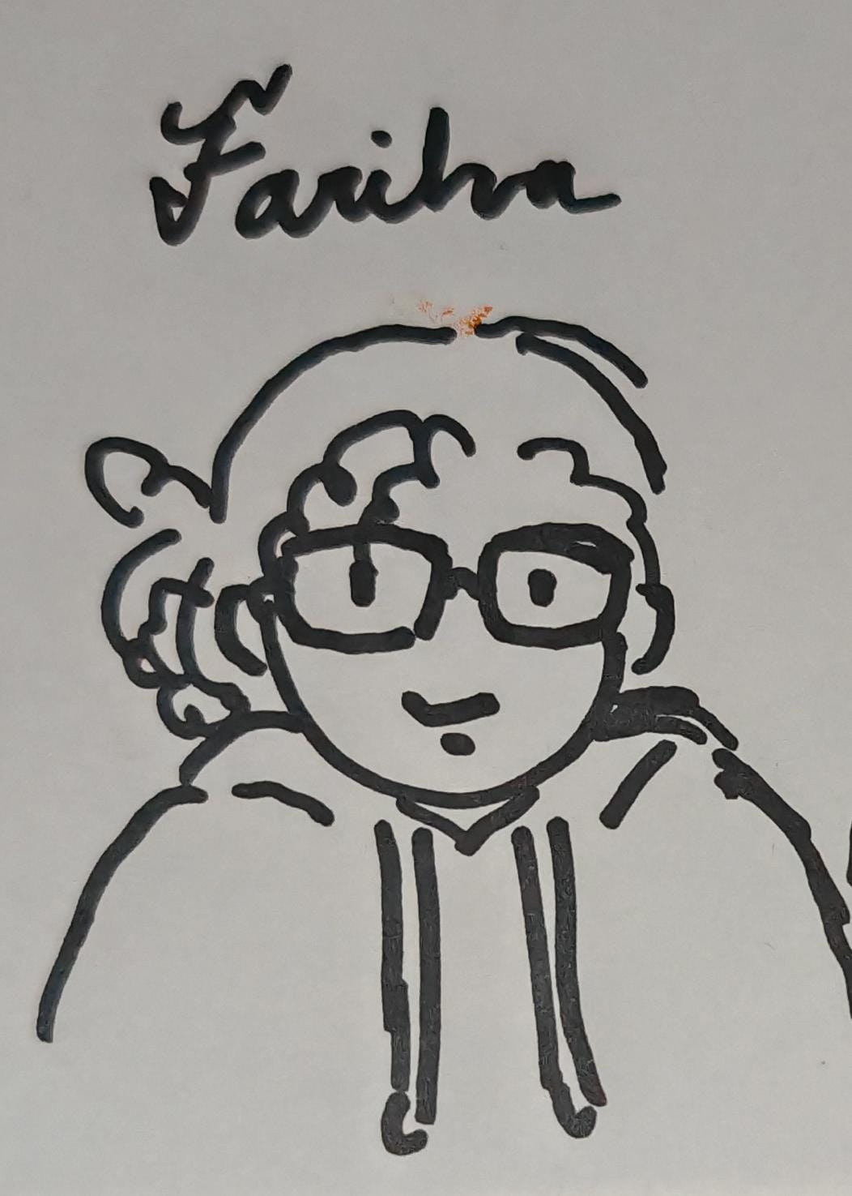
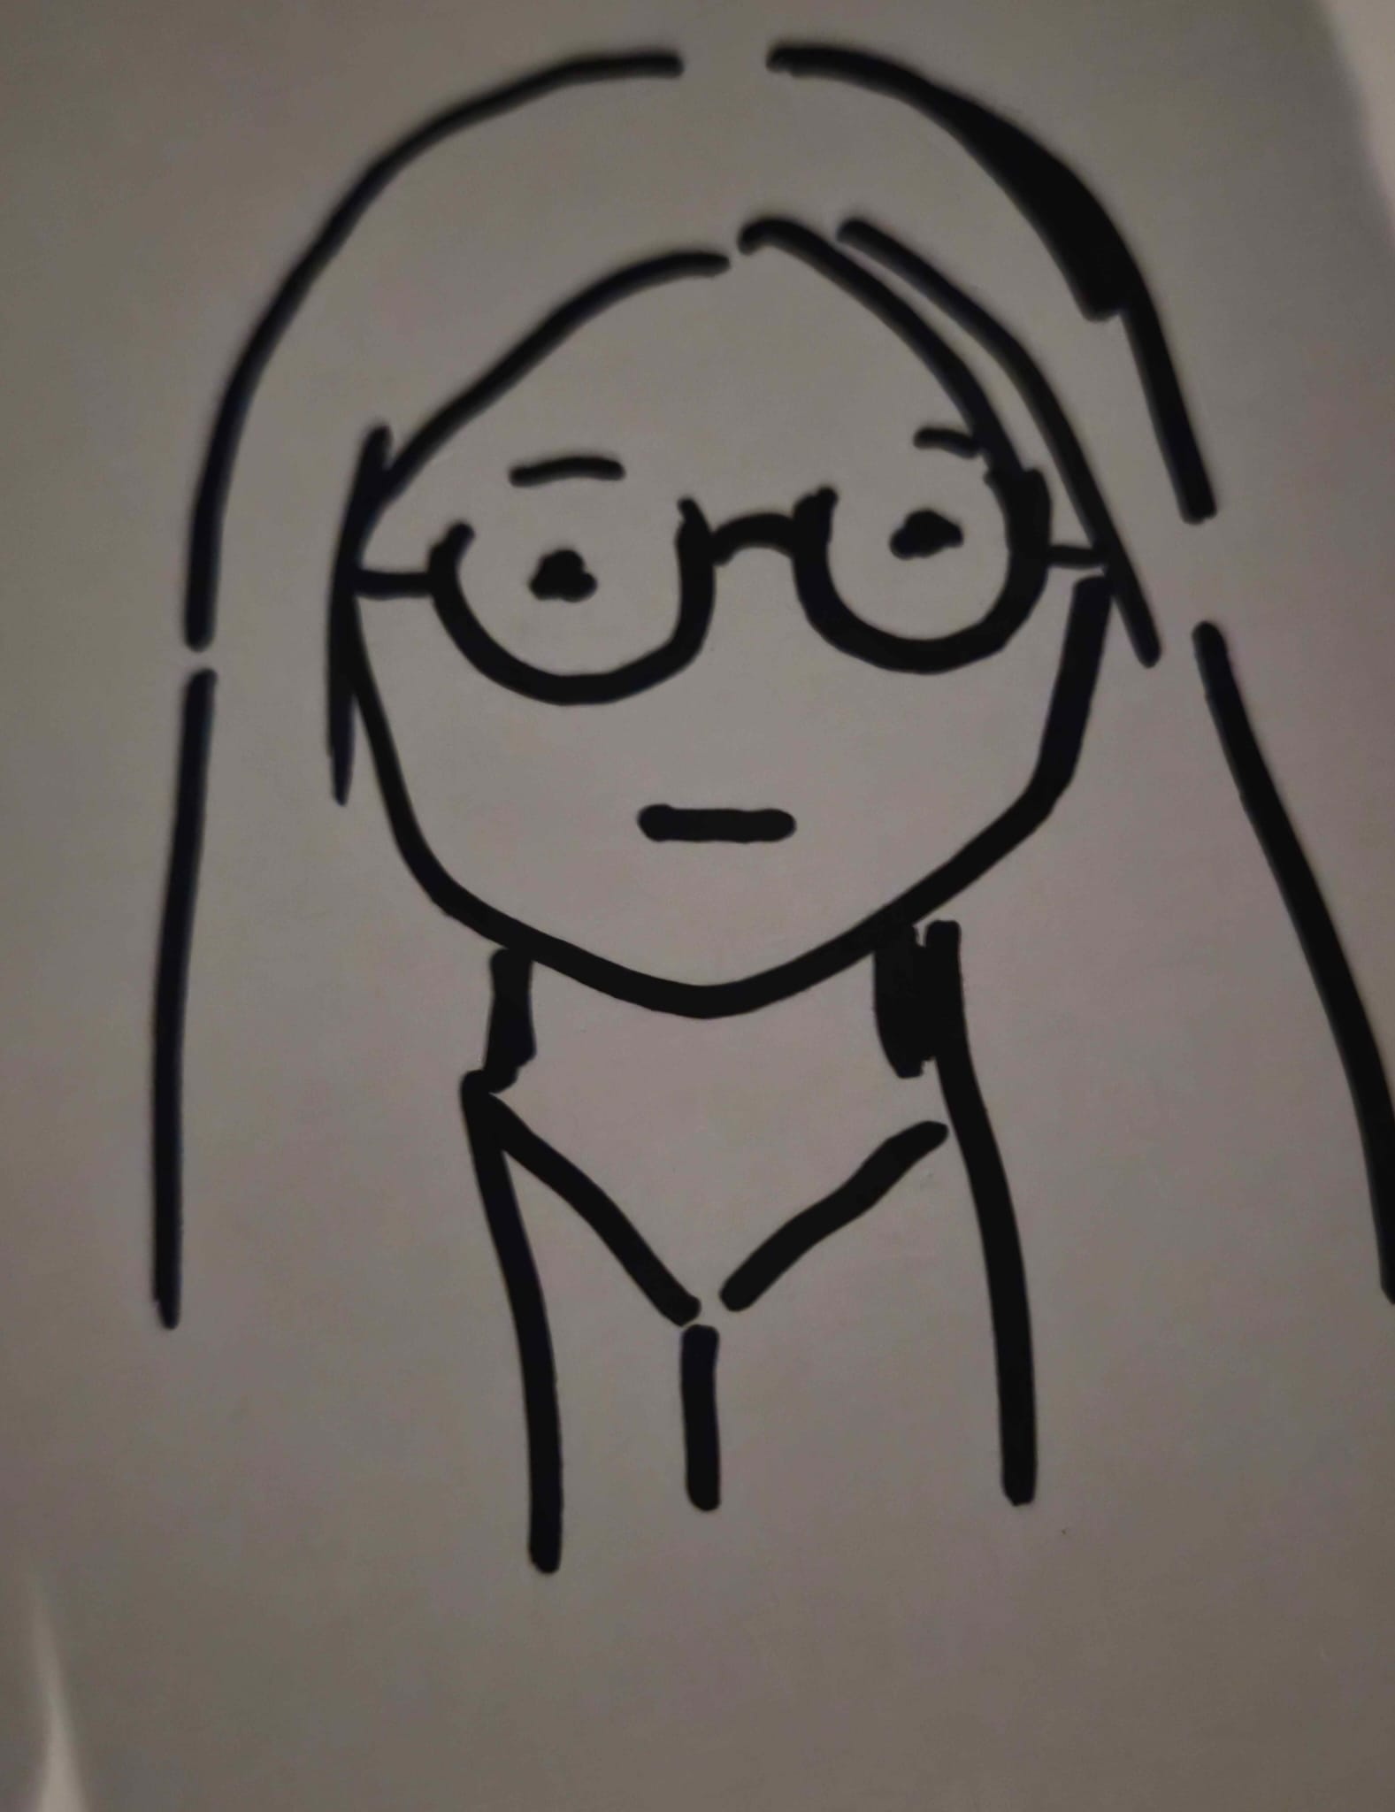
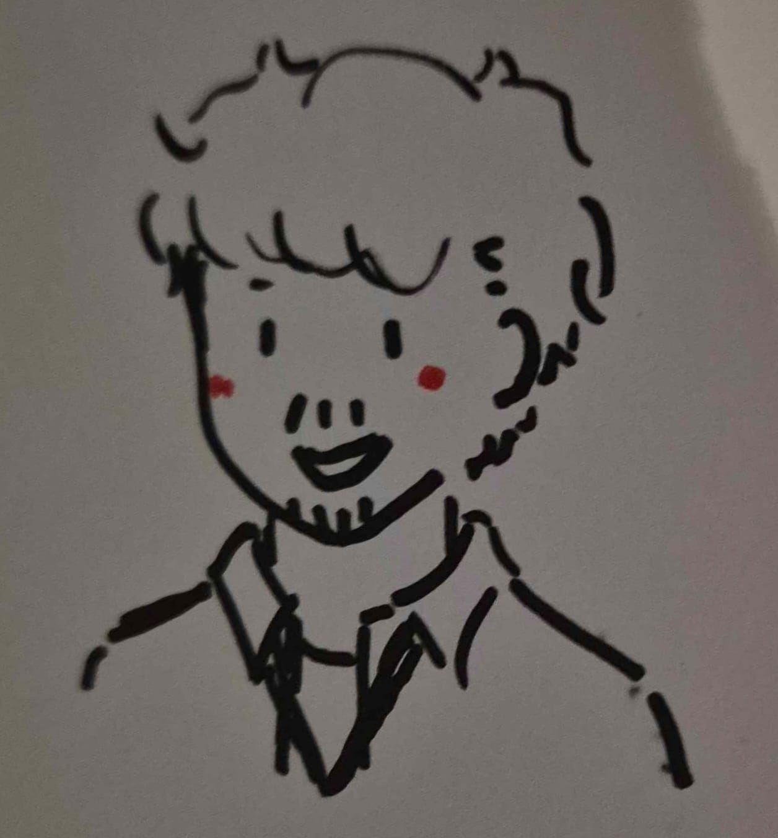
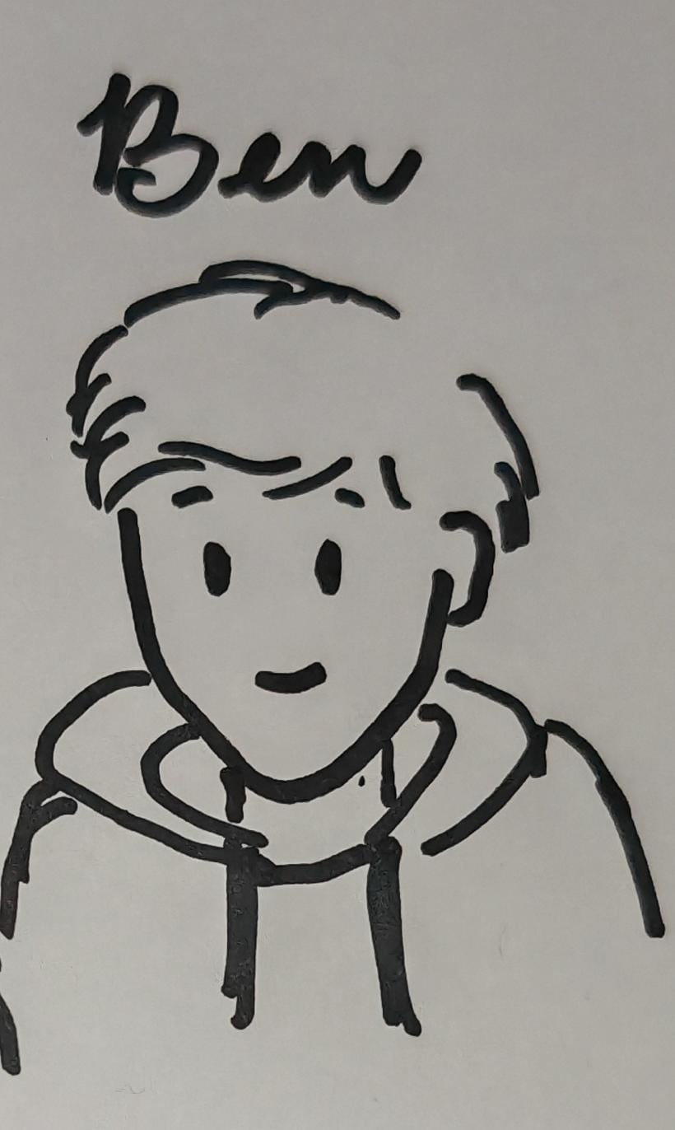
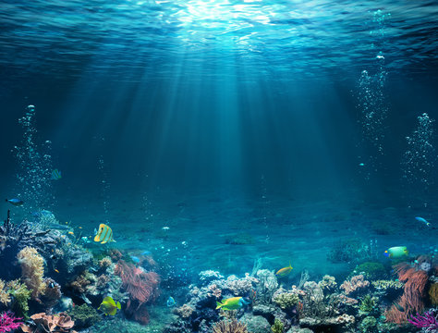

Slide 4

Challenge

Slide 5
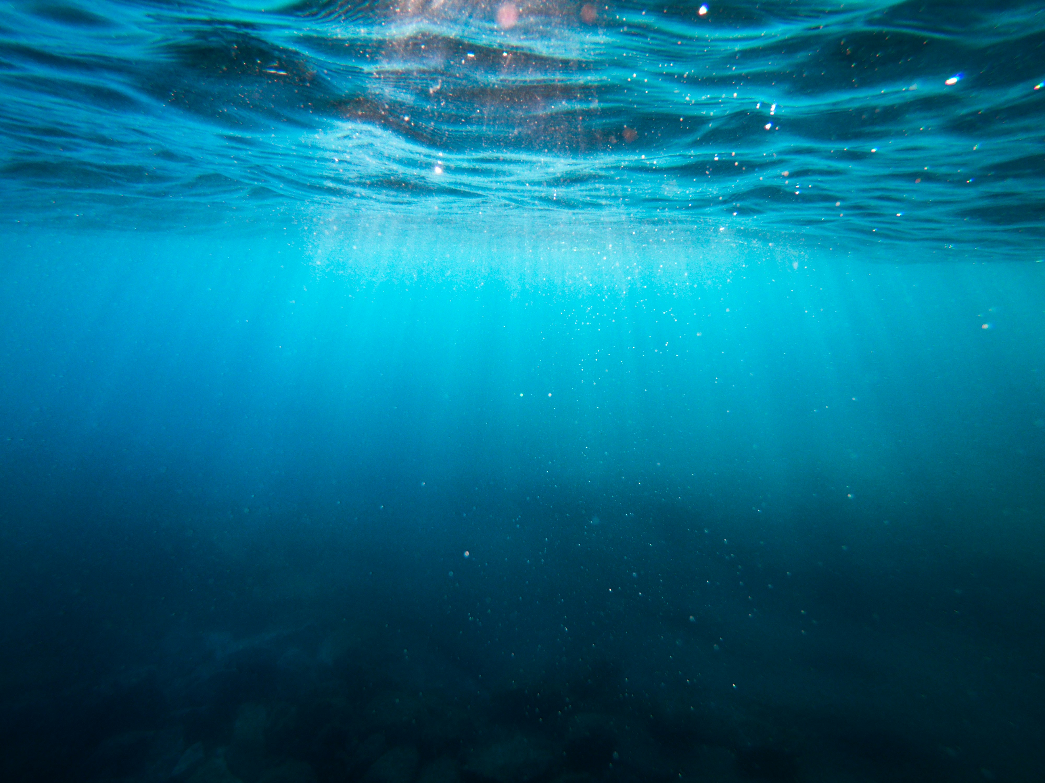
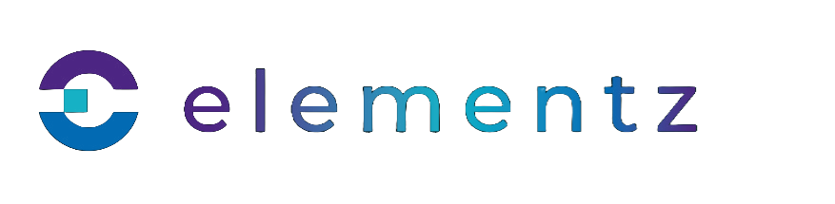
CHALLENGE
Why: a new challenge for of us.
What is the challenge:
Display subsea points of interest (vessels, assets, pipelines) using 2D overlays or simple 3D models.
Use basic shapes
Color-code objects for easy identification.
Pipelines should follow the Earth's curve without requiring separate models.
Notes:
Why? because of the meta headset but then we realise it’s not even related.
Jk the actual reason is Because we liked the challenge, as it’s something none of implemented before

Slide 6

SOLUTION

Slide 7
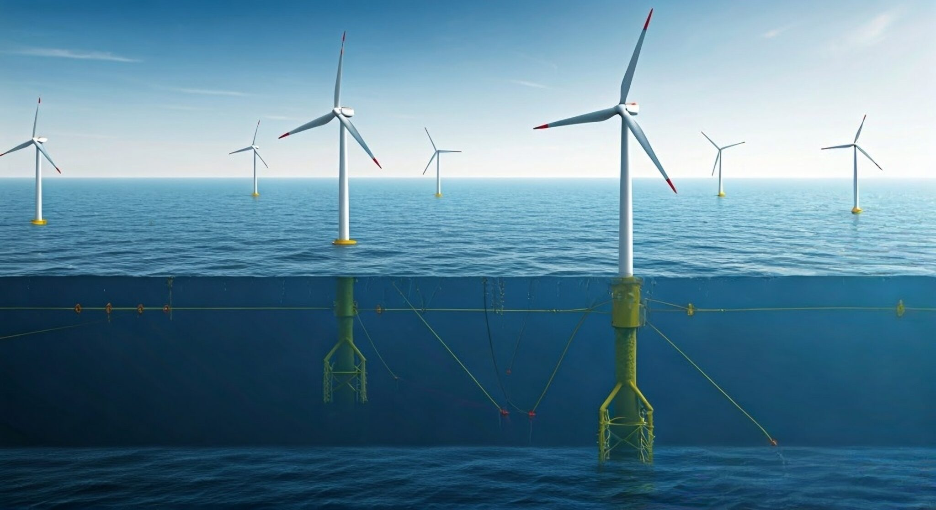
SOLUTION
Our goals are based on the challenges set by the sponsors. This Is what we have managed to do so far:
Website setup with a Google Earth-style view for subsea assets and pipelines.
API integrated to display latitude/longitude coordinates.
Shapes and colours applied for asset and pipeline distinction.
Zoom feature with popups showing asset details (name, location, anomalies).
Filtering options added for asset type, health status, and anomaly count.
Additional details included, such as floating health icons.
UI with Elementz branding colours
.

Slide 8

Future
Changes

Slide 9
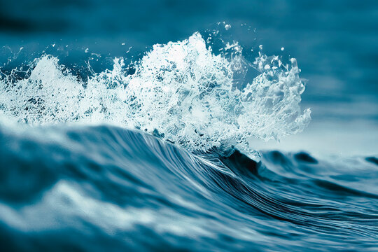
FUTURE
CHANGES
Implement the weather Api
Mobile friendly interface
Build more features
Notes:
Why? because of the meta headset but then we realise it’s not even related.
Jk the

